Slide 1
The big O

Slide 2
Why?
To estimate the efficiency of an algorithm

Slide 3
How to estimate efficiency?
sum = 0;
for (int i = 1; i <= n; i++)
s = s + i;
return s;
1. Assignment
Increase
Checking
Lines: 2n + 2

Slide 4
The idea of the big O
How many lines of code are being executed
How elapsing time changes with the change of data

Slide 5
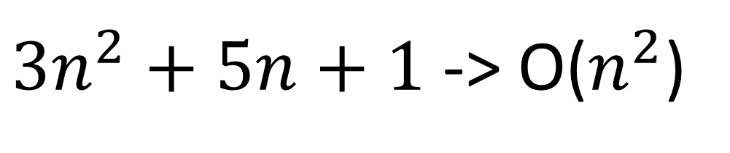

Example
$3n^{2}+5n+1$ -> O($n^{2}$)
$$3n^{2}+5n+1$$

Slide 6
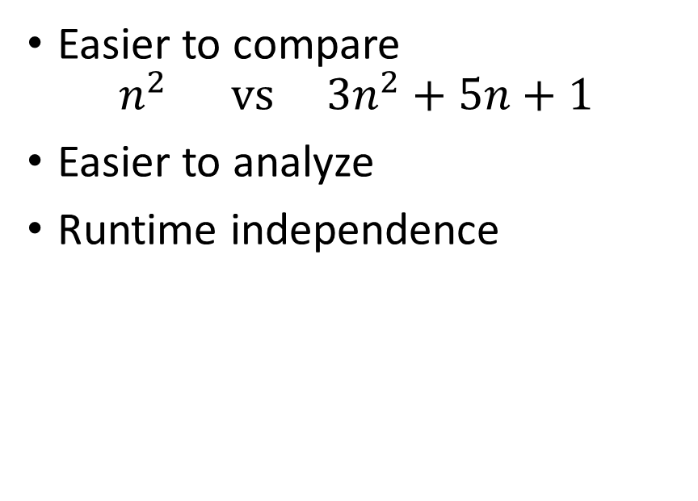
The big O
Pros
Cons
Easier to compare
$$n^{2} vs 3n^{2}+5n+1$$
Easier to analyze
Runtime independence
Hides constant factors
Does not show the real estimating time

